Slide 1
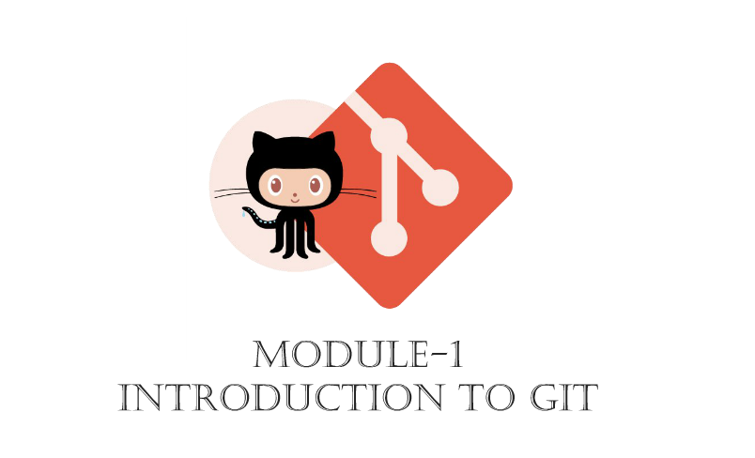

Slide 2
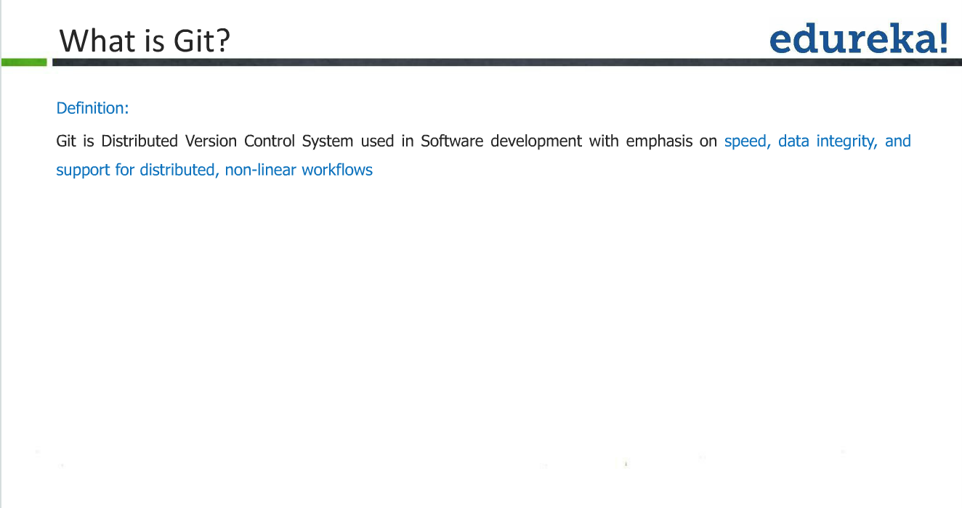

Slide 3

Brief History
As with many great things in life, Git began with a bit of creative destruction and fiery controversy.
For most of the lifetime of the Linux kernel maintenance (1991–2002), changes to the software were passed around as patches and archived files. In 2002, the Linux kernel project began using a proprietary DVCS called BitKeeper.
In 2005, the relationship between the community that developed the Linux kernel and the commercial company that developed BitKeeper broke down, and the tool’s free-of-charge status was revoked.
Linux development community (and in particular Linus Torvalds, the creator of Linux) to develop their own tool based on some of the lessons they learned
https://youtu.be/GTMC3g2Xy8c
Linus Torvalds

Slide 4
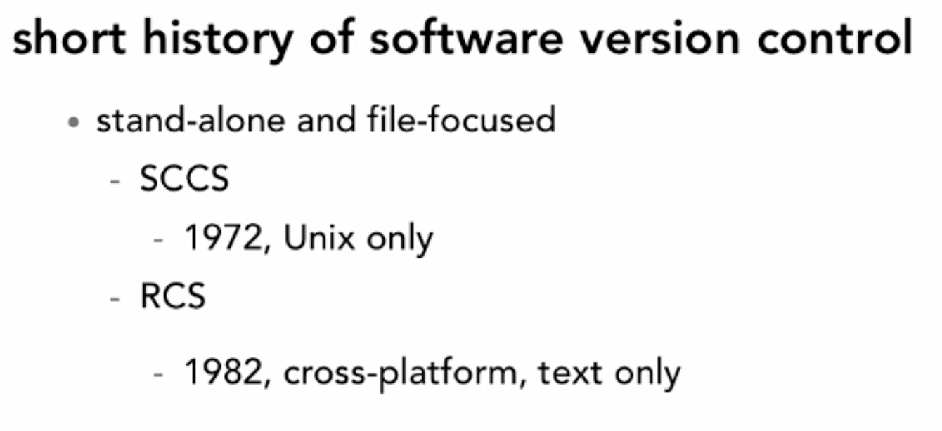

Slide 5
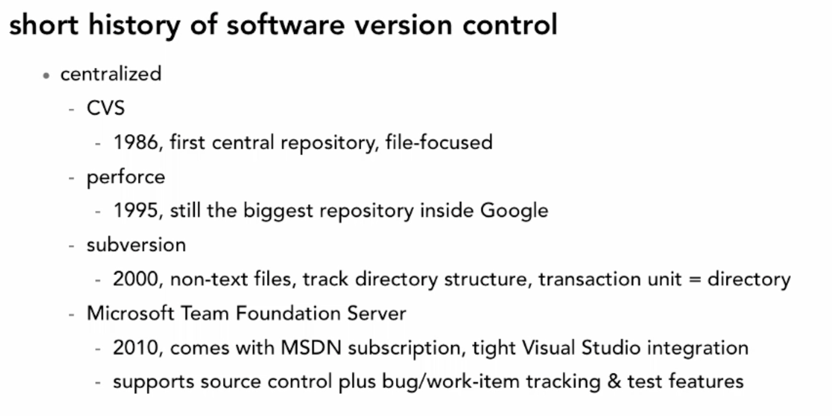

Slide 6
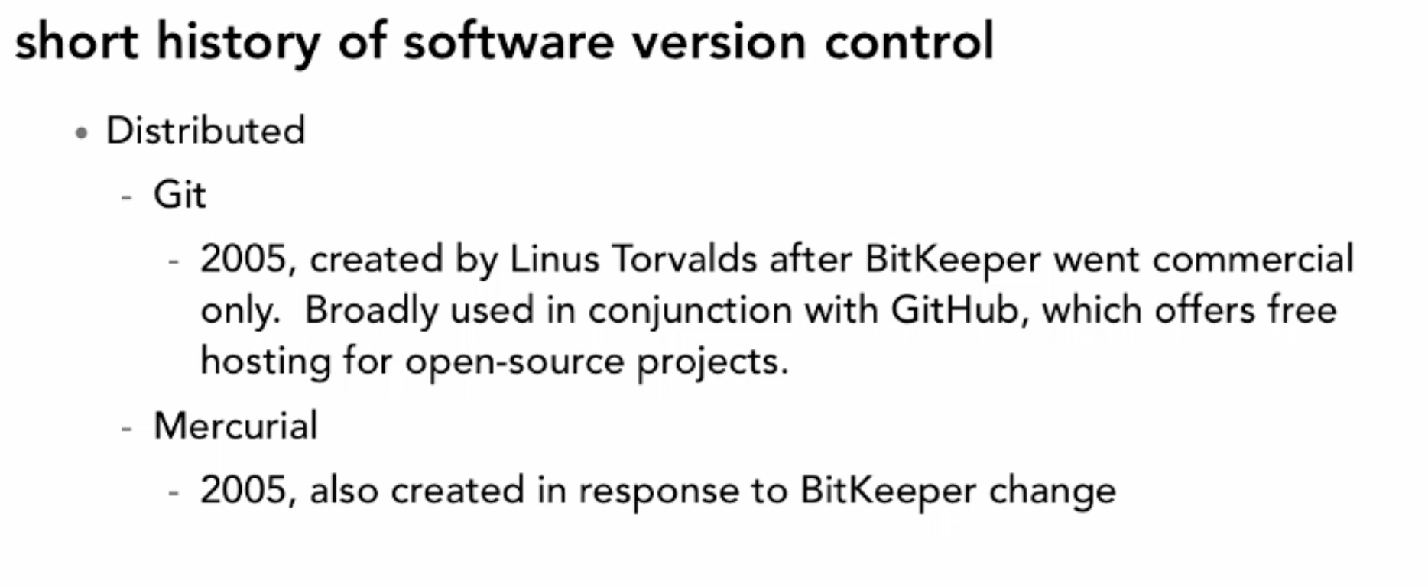

Slide 7
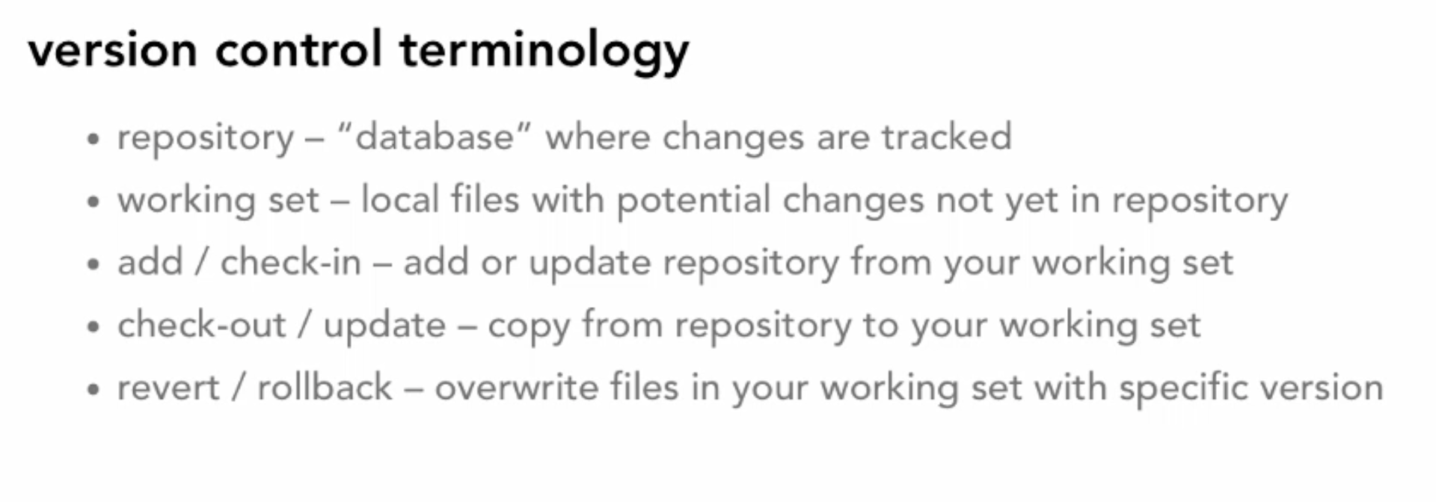

Slide 8
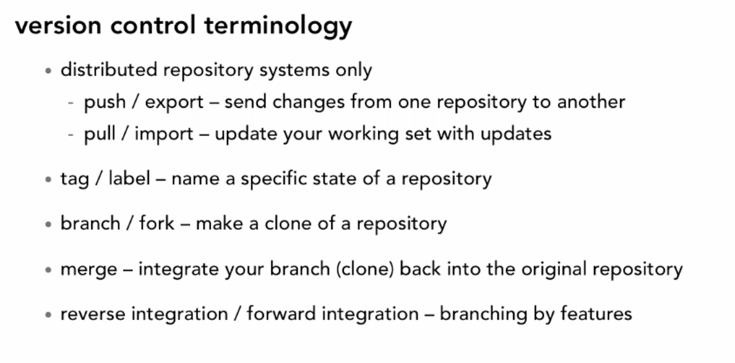

Slide 9
Why Do We Need A Version Control System (VCS)?
Backup and Restore. Files are saved as they are edited, and you can jump to any moment in time. Need that file as it was on Feb 23, 2007? No problem.
Synchronization. Lets people share files and stay up-to-date with the latest version.
Short-term undo. Monkeying with a file and messed it up? (That’s just like you, isn’t it?). Throw away your changes and go back to the “last known good” version in the database.
Long-term undo. Sometimes we mess up bad. Suppose you made a change a year ago, and it had a bug. Jump back to the old version, and see what change was made that day.
Track Changes. As files are updated, you can leave messages explaining why the change happened (stored in the VCS, not the file). This makes it easy to see how a file is evolving over time, and why.
Track Ownership. A VCS tags every change with the name of the person who made it.
Sandboxing, or insurance against yourself. Making a big change? You can make temporary changes in an isolated area, test and work out the kinks before “checking in” your changes.
Branching and merging. A larger sandbox. You can branch a copy of your code into a separate area and modify it in isolation (tracking changes separately). Later, you can merge your work back into the common area.

Slide 10
Learn the Lingo (Basic Set up)
Repository (repo): The database storing the files.
Server: The computer storing the repo.
Client: The computer connecting to the repo.
Working Set/Working Copy: Your local directory of files, where you make changes.
Trunk/Main: The primary location for code in the repo. Think of code as a family tree — the trunk is the main line.

Slide 11
Learn the Lingo (Basic Actions)
Add: Put a file into the repo for the first time, i.e. begin tracking it with Version Control.
Revision: What version a file is on (v1, v2, v3, etc.).
Head: The latest revision in the repo.
Check out: Download a file from the repo.
Check in: Upload a file to the repository (if it has changed). The file gets a new revision number, and people can “check out” the latest one.
Checkin Message: A short message describing what was changed.
Changelog/History: A list of changes made to a file since it was created.
Update/Sync: Synchronize your files with the latest from the repository. This lets you grab the latest revisions of all files.
Revert: Throw away your local changes and reload the latest version from the repository.

Slide 12
Learn the Lingo (Advanced Actions)
Branch: Create a separate copy of a file/folder for private use (bug fixing, testing, etc). Branch is both a verb (“branch the code”) and a noun (“Which branch is it in?”).
Diff/Change/Delta: Finding the differences between two files. Useful for seeing what changed between revisions.
Merge (or patch): Apply the changes from one file to another, to bring it up-to-date. For example, you can merge features from one branch into another. (At Microsoft this was called Reverse Integrate and Forward Integrate)
Conflict: When pending changes to a file contradict each other (both changes cannot be applied).
Resolve: Fixing the changes that contradict each other and checking in the correct version.
Locking: Taking control of a file so nobody else can edit it until you unlock it. Some version control systems use this to avoid conflicts.
Breaking the lock: Forcibly unlocking a file so you can edit it. It may be needed if someone locks a file and goes on vacation (or “calls in sick” the day Halo 3 comes out).
Check out for edit: Checking out an “editable” version of a file. Some VCSes have editable files by default, others require an explicit command.

Slide 13
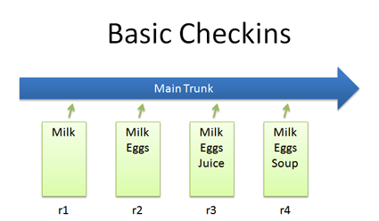
Basic Checkins

Slide 14
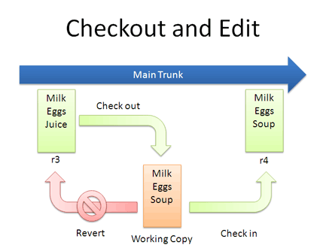
Checkout and Edit

Slide 15
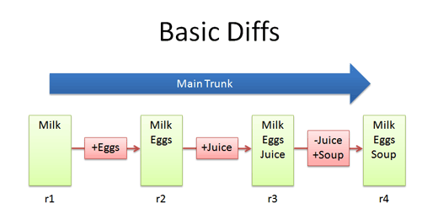
Basic Diffs

Slide 16
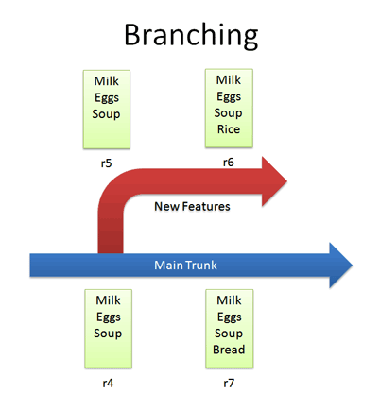
Branching

Slide 17
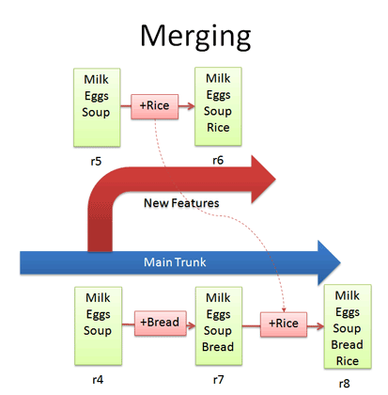
Merging

Slide 18
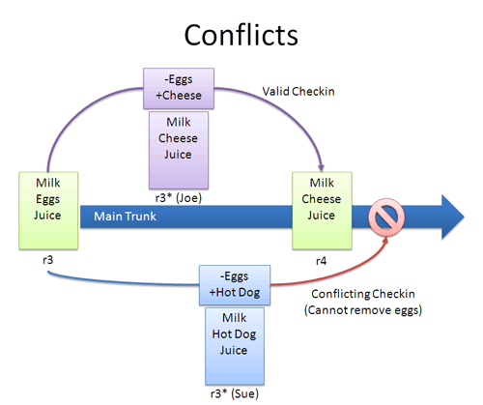
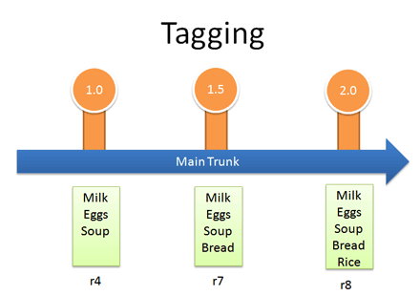
Conflicts and Tagging

Slide 19
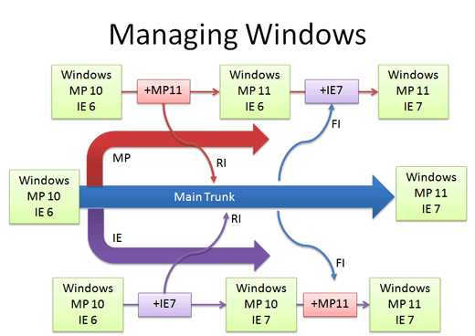
Real life example: Managing Windows versions

Slide 20
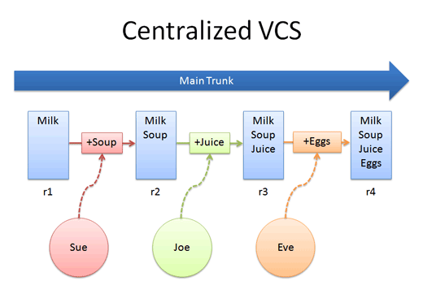
Centralized VCS

Slide 21
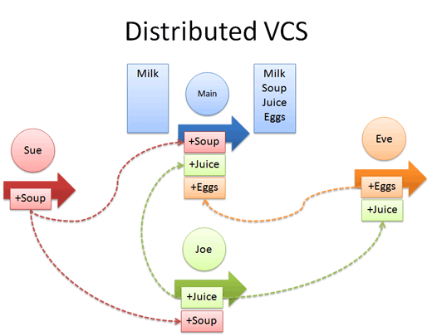
Distributed VCS

Slide 22
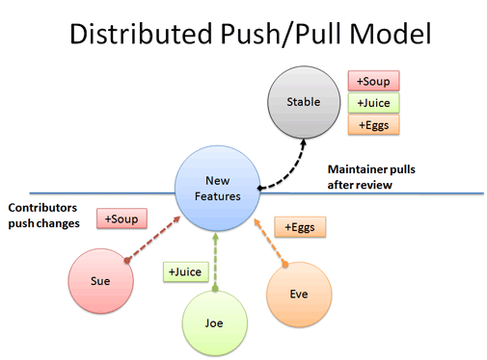
Distributed Push/Pull Model

Slide 23
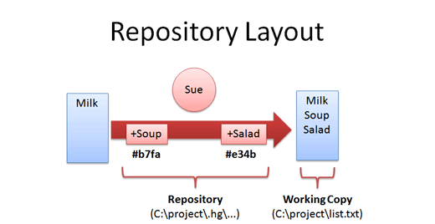
Repository Layout

Slide 24
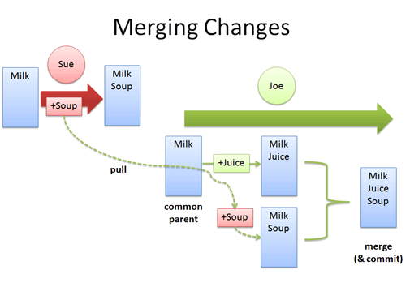
Merging Changes

Slide 25
Distributed Push/Pull Model

Slide 26
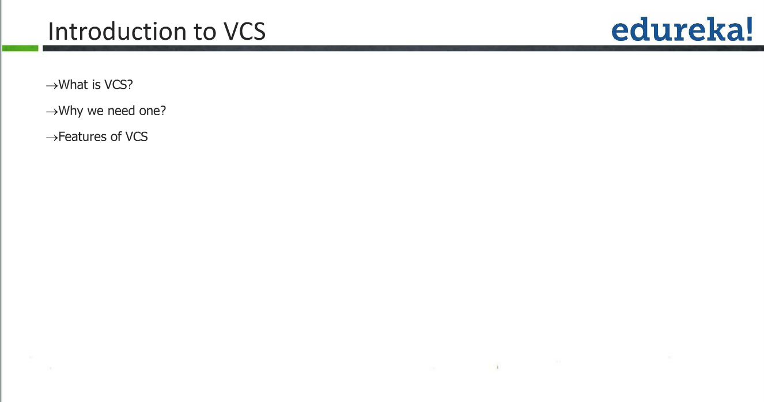

Slide 27
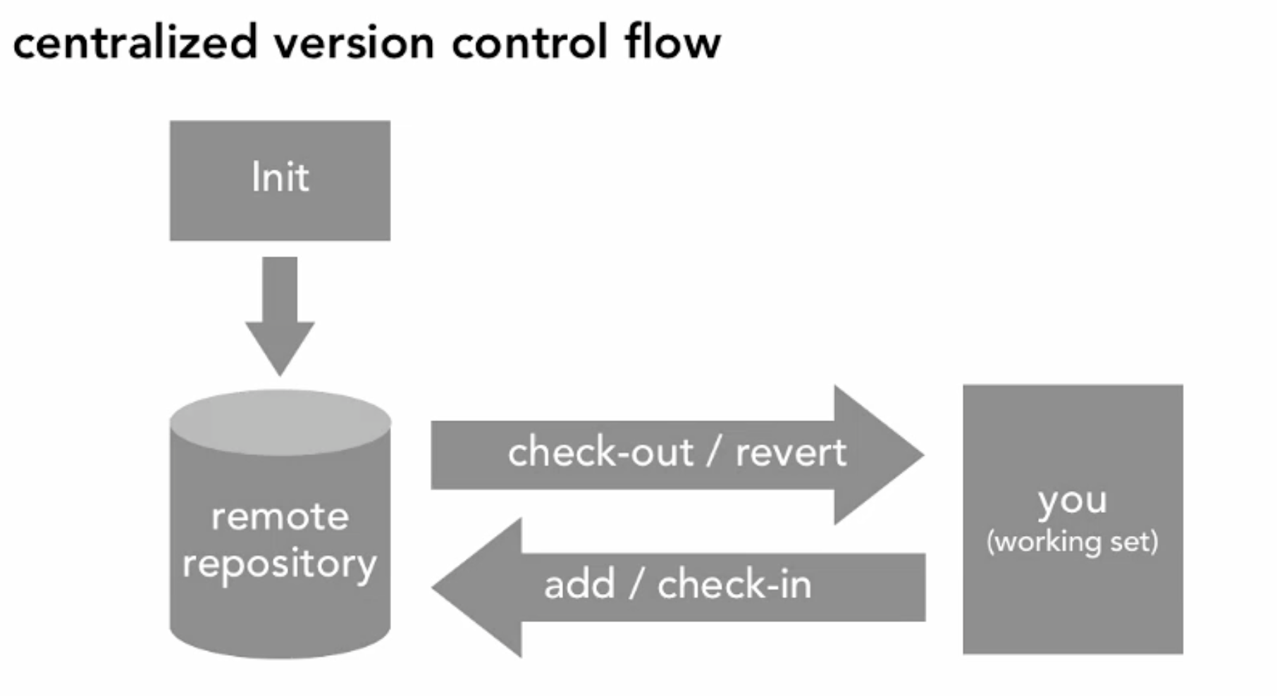

Slide 28
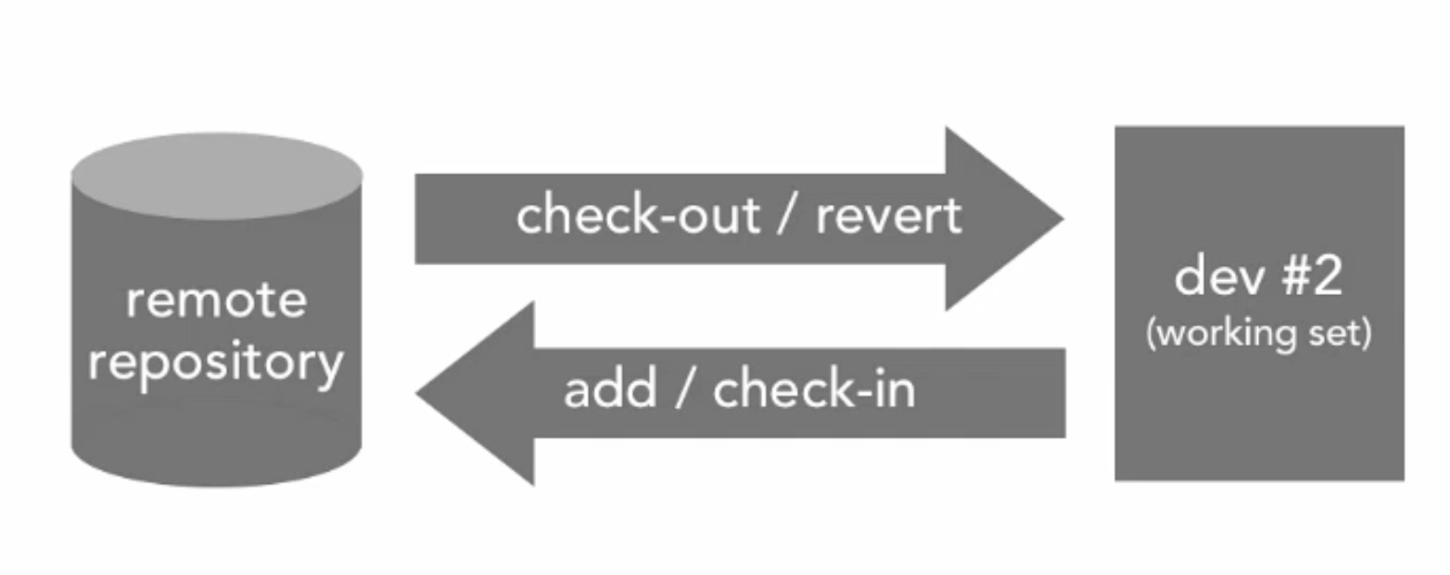

Slide 29
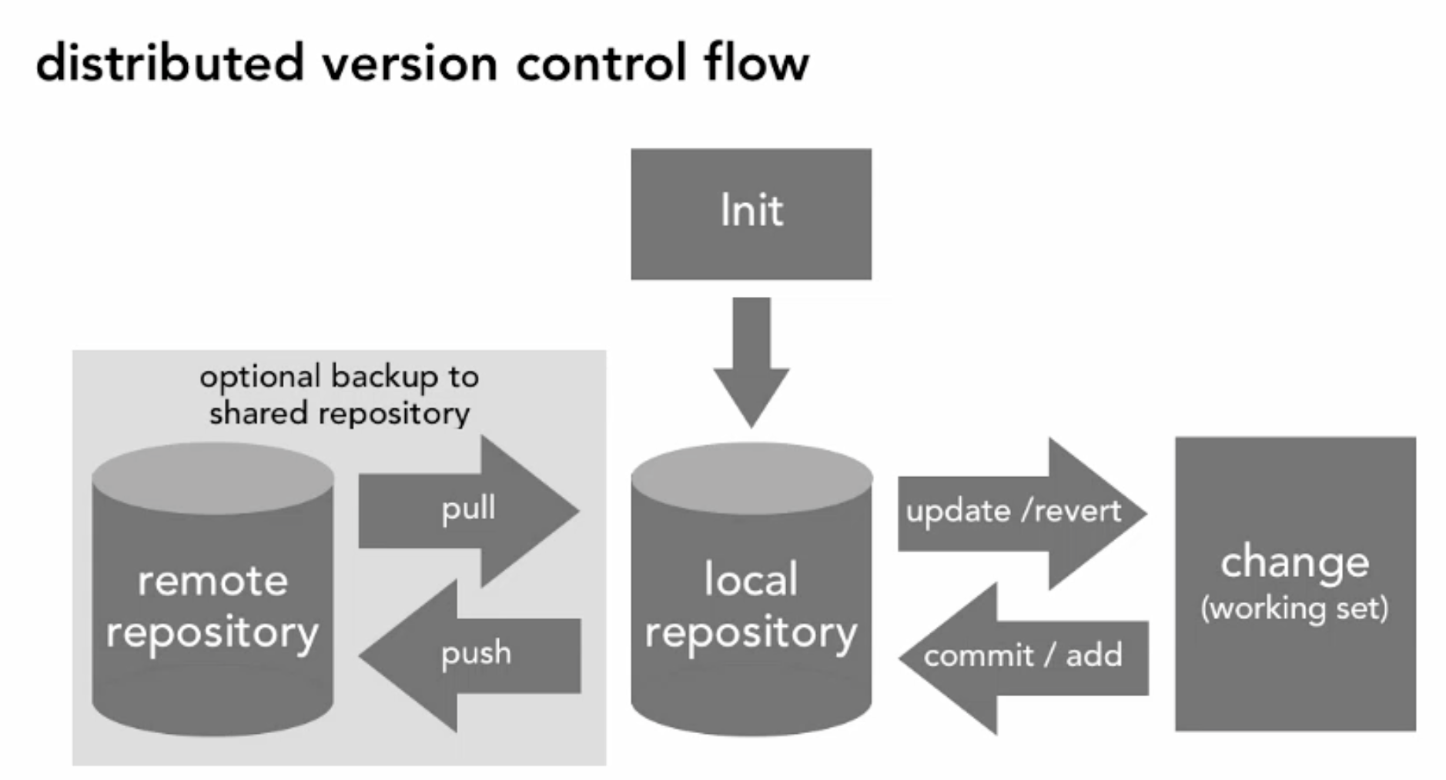

Slide 30
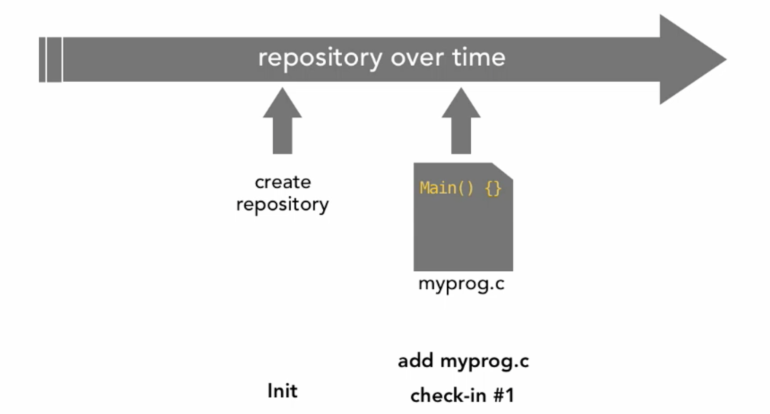

Slide 31
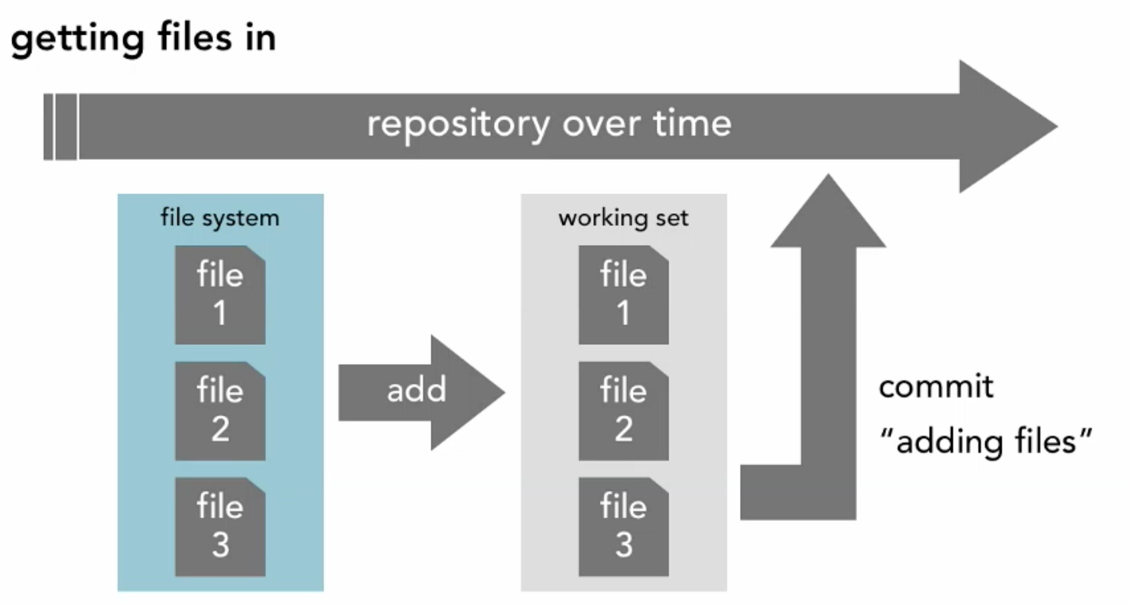

Slide 32
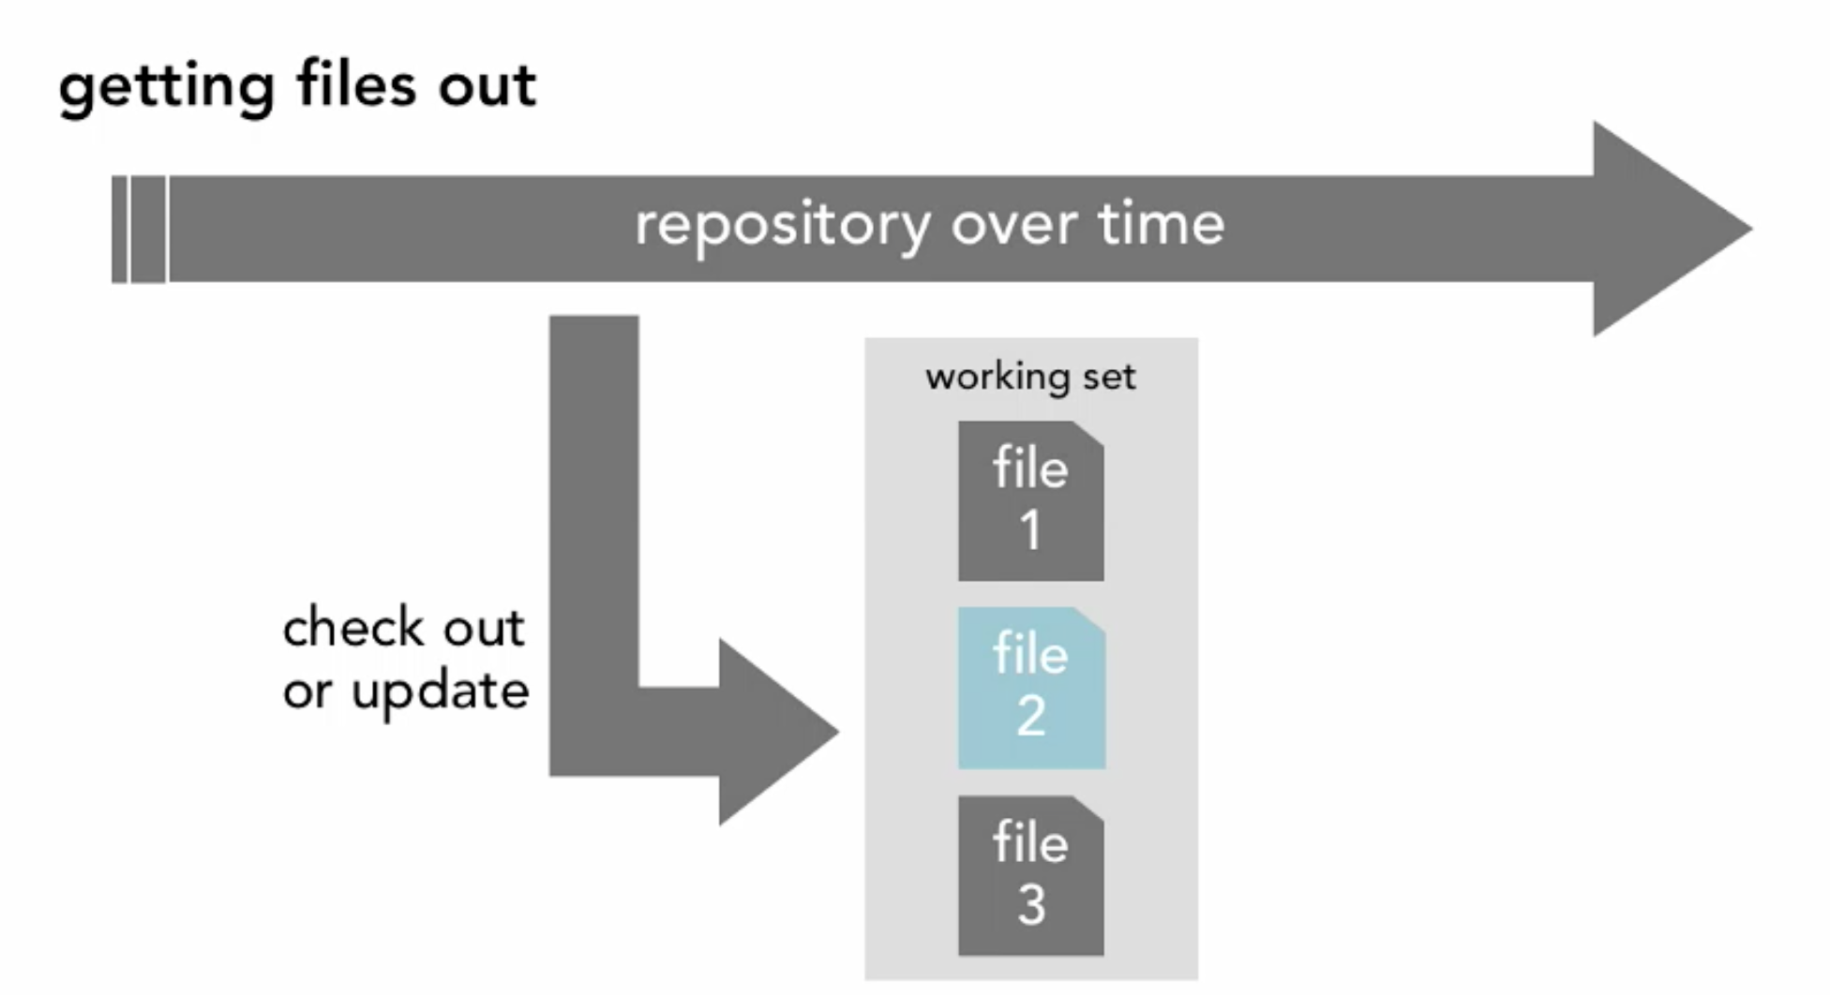

Slide 33
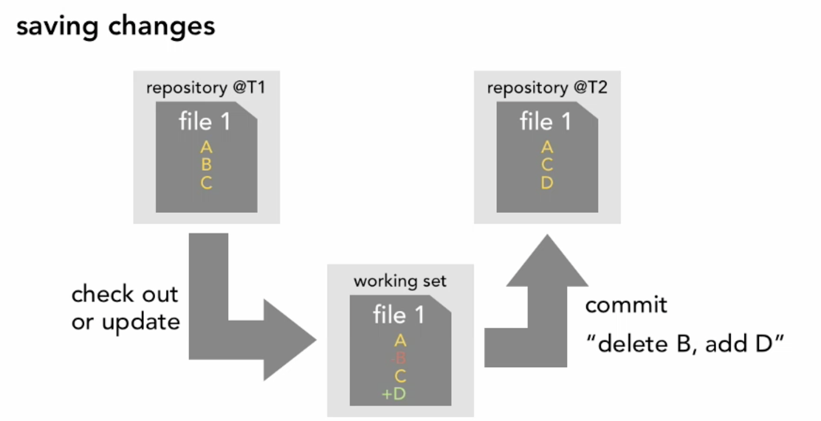

Slide 34
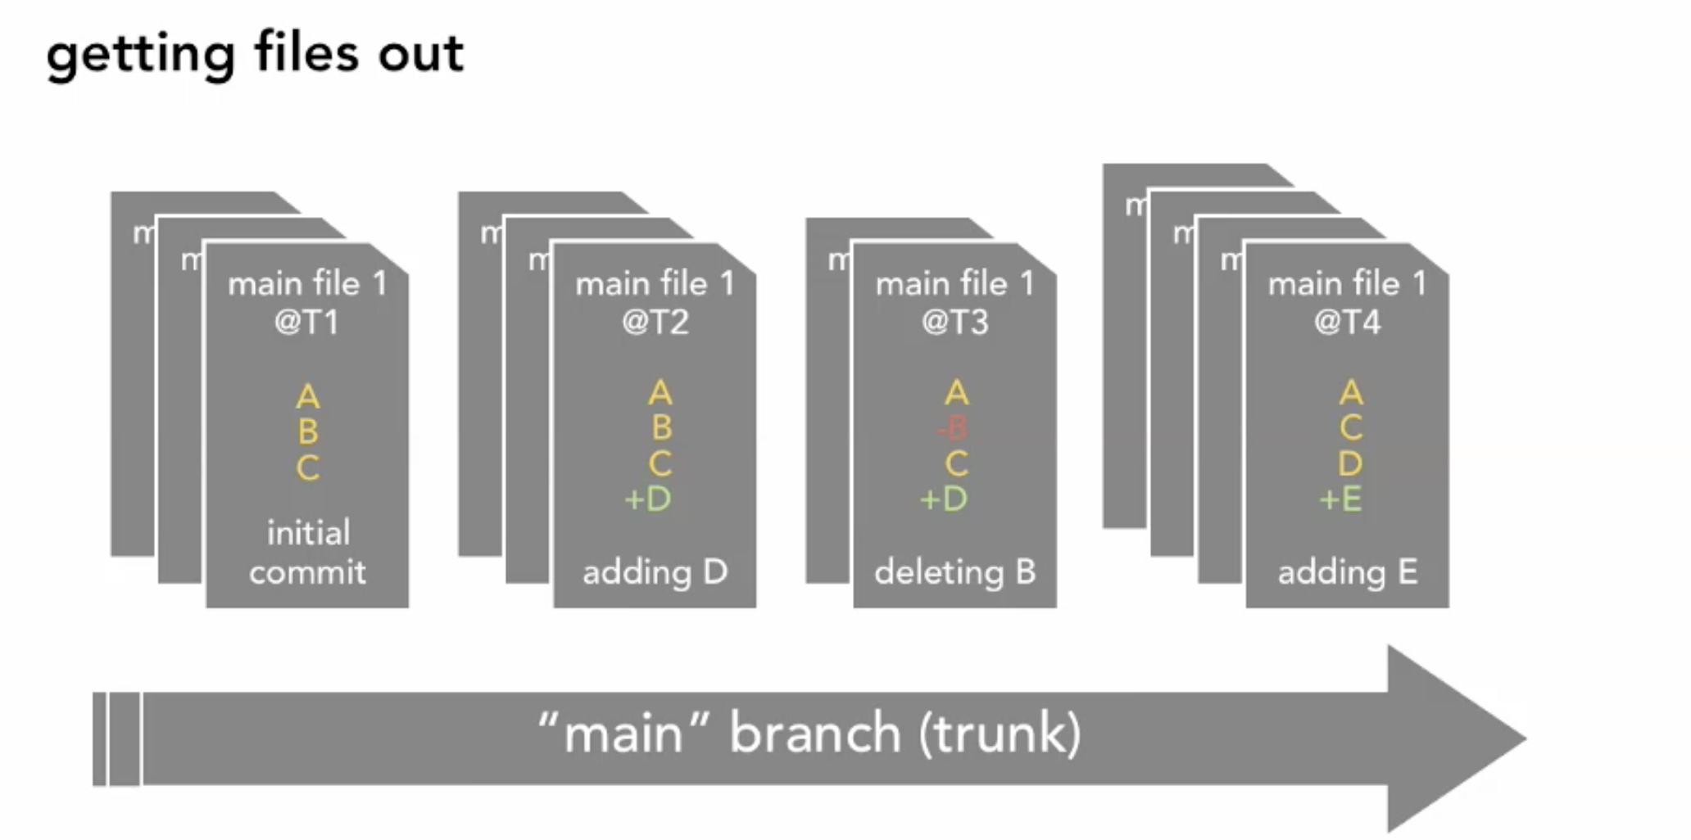

Slide 35
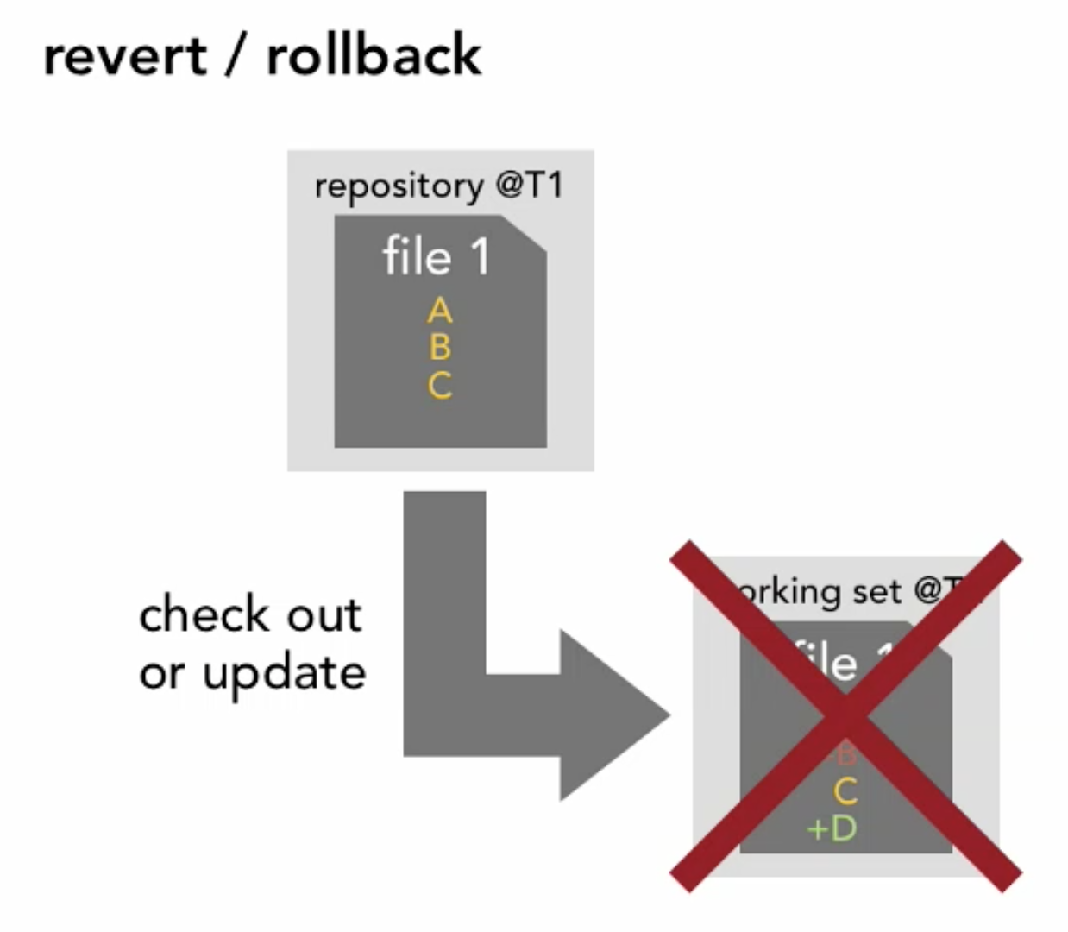

Slide 36
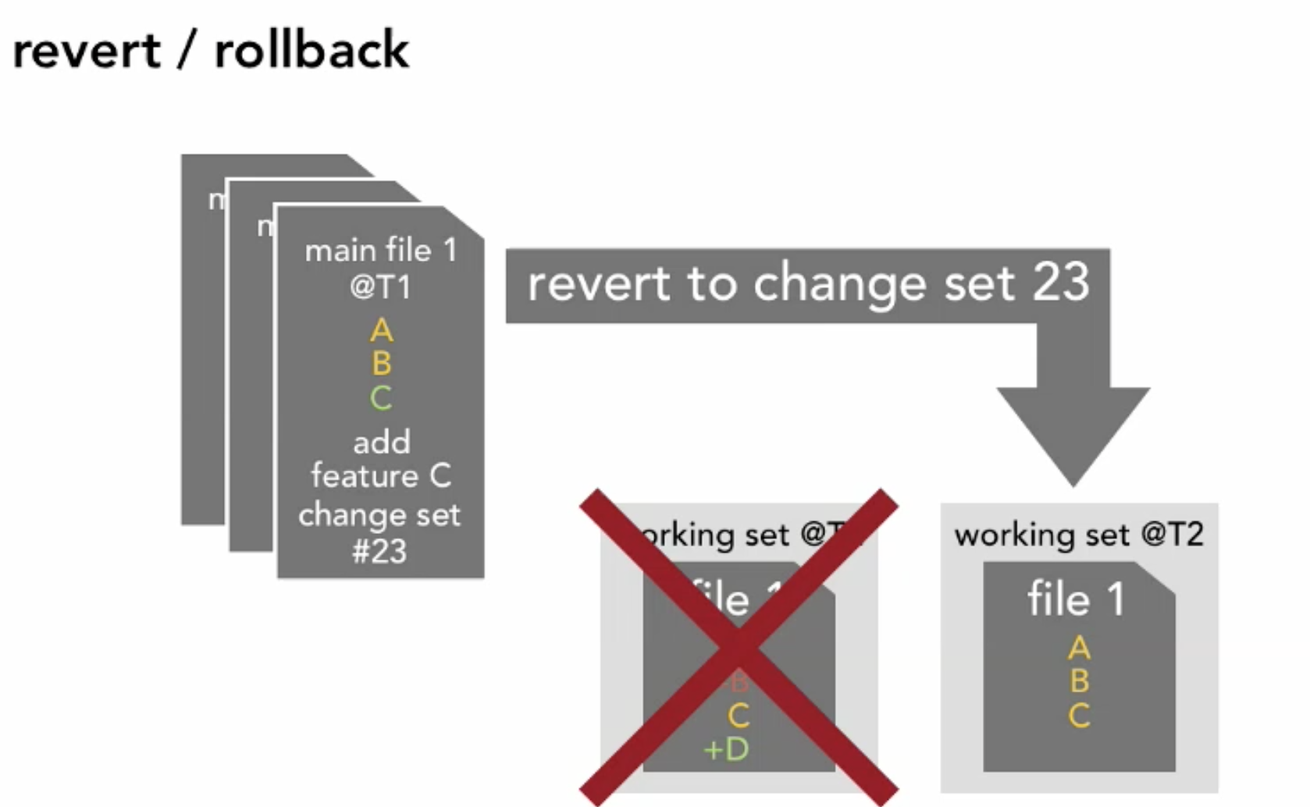

Slide 37
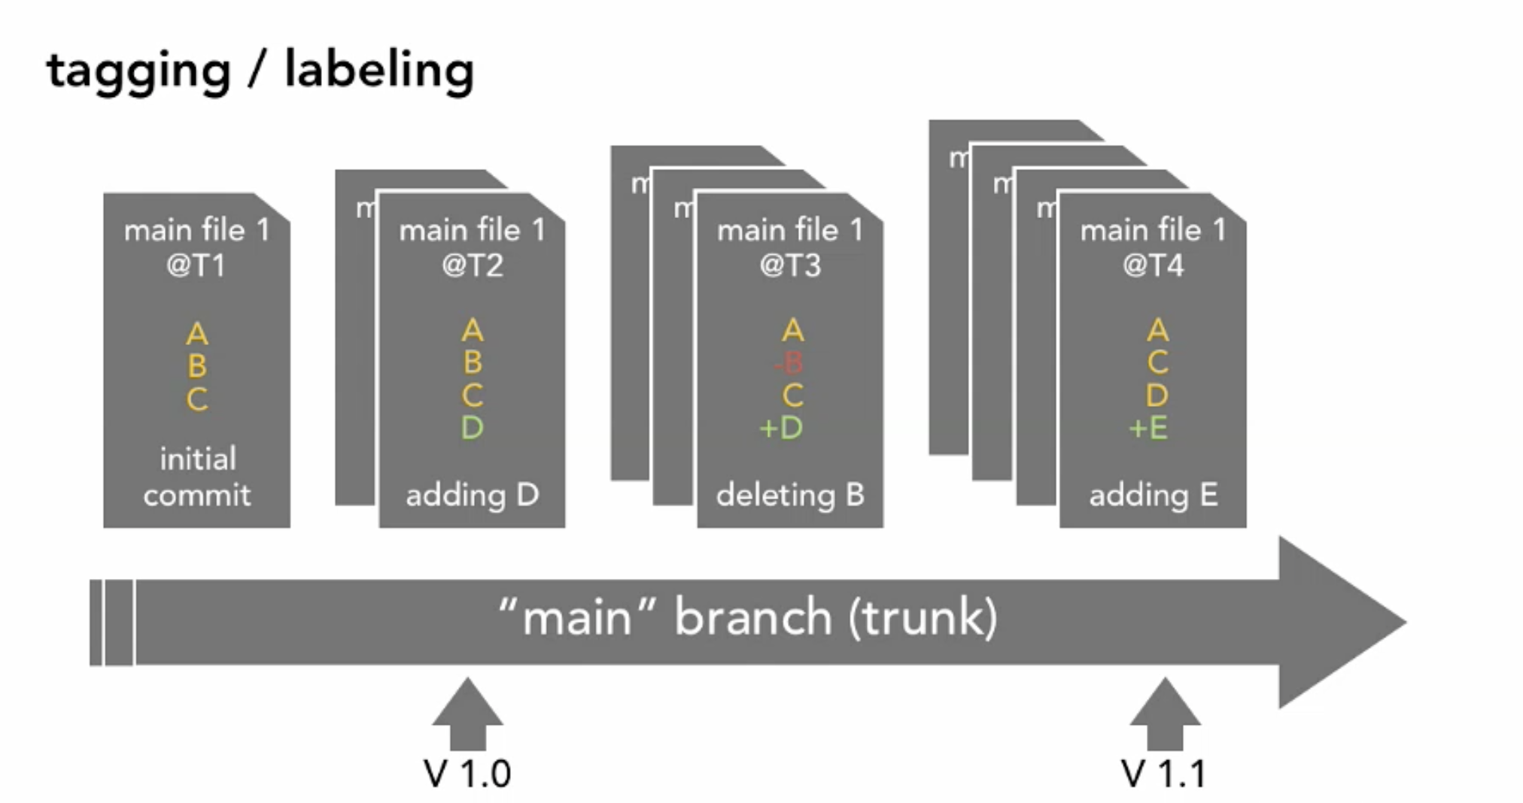

Slide 38
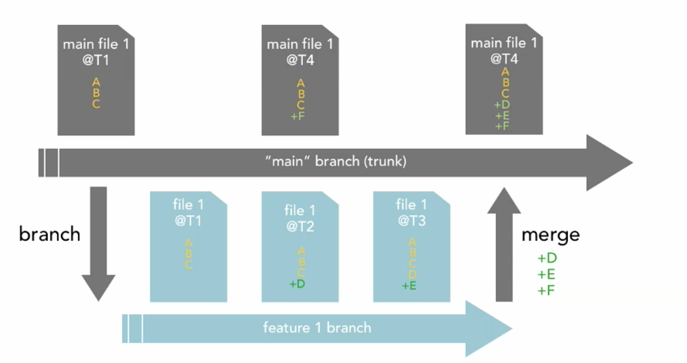
Branching and Merging

Slide 39
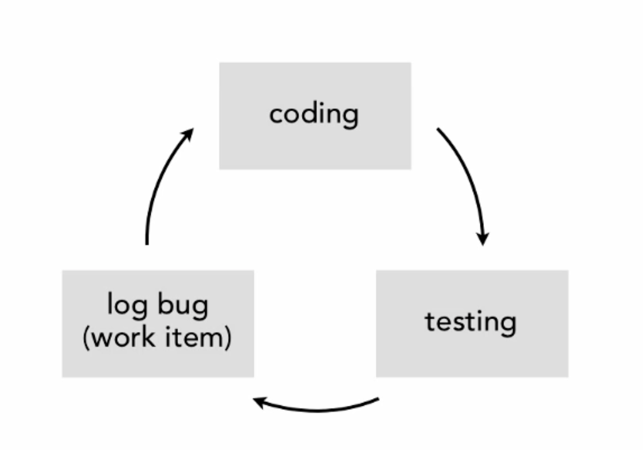
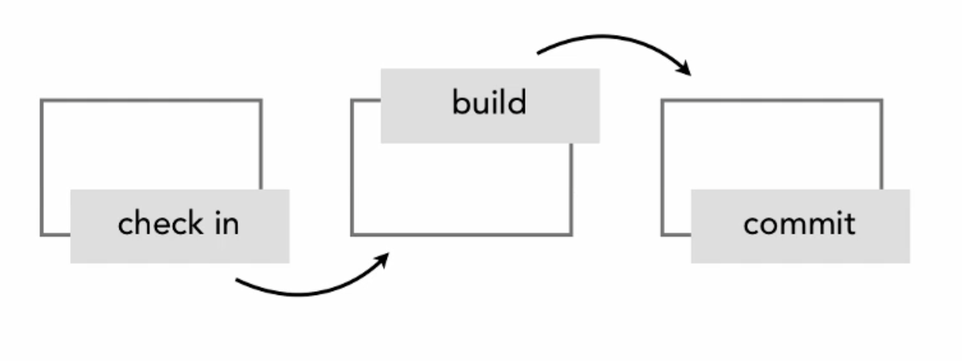
Version control life cycle

Slide 40
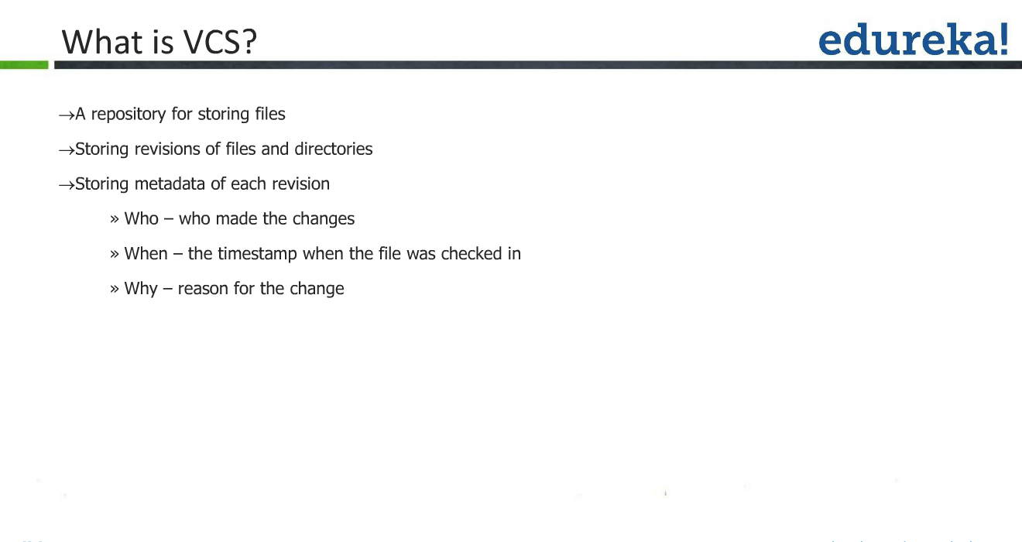

Slide 41
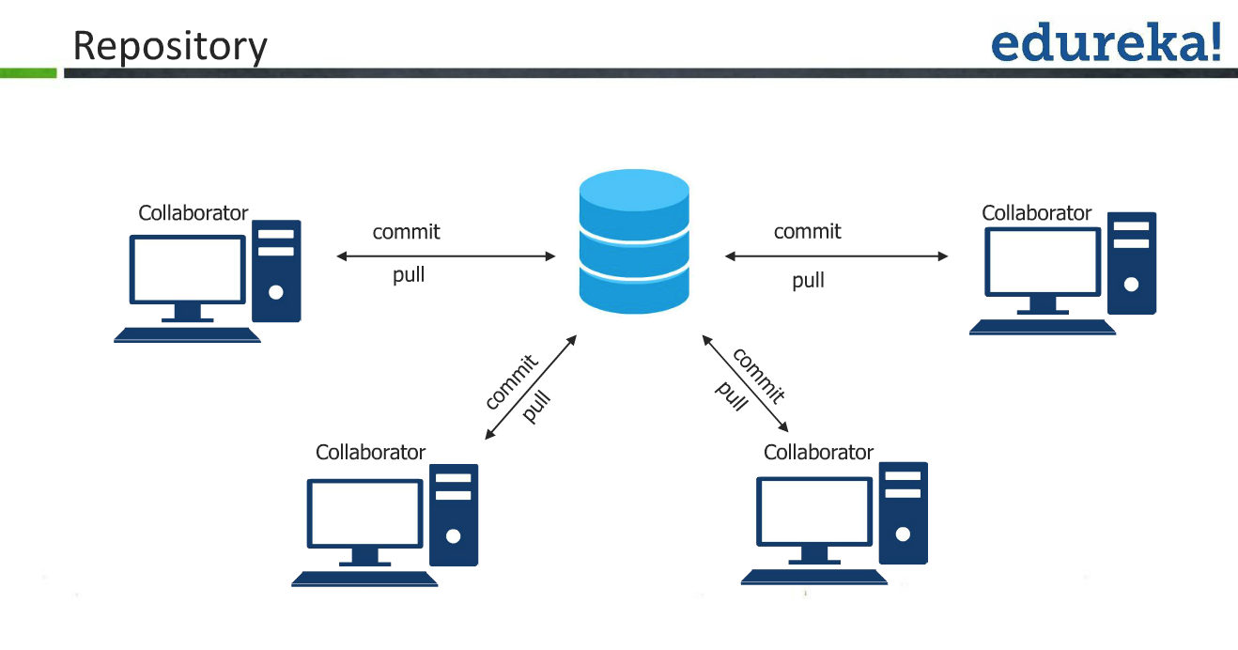

Slide 42
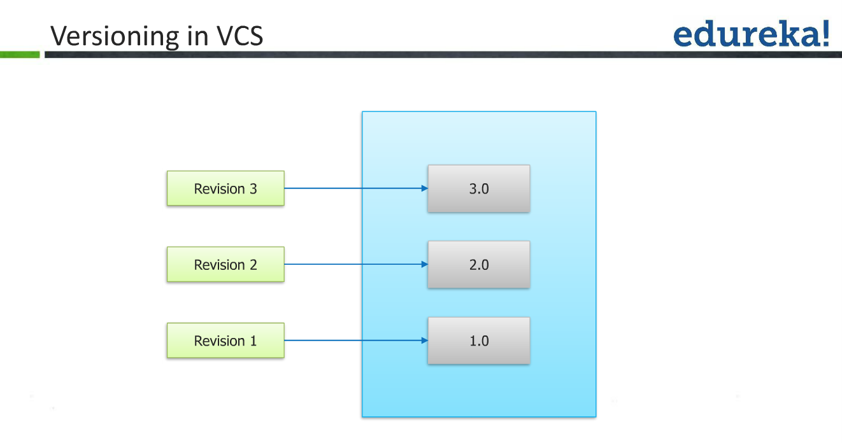

Slide 43
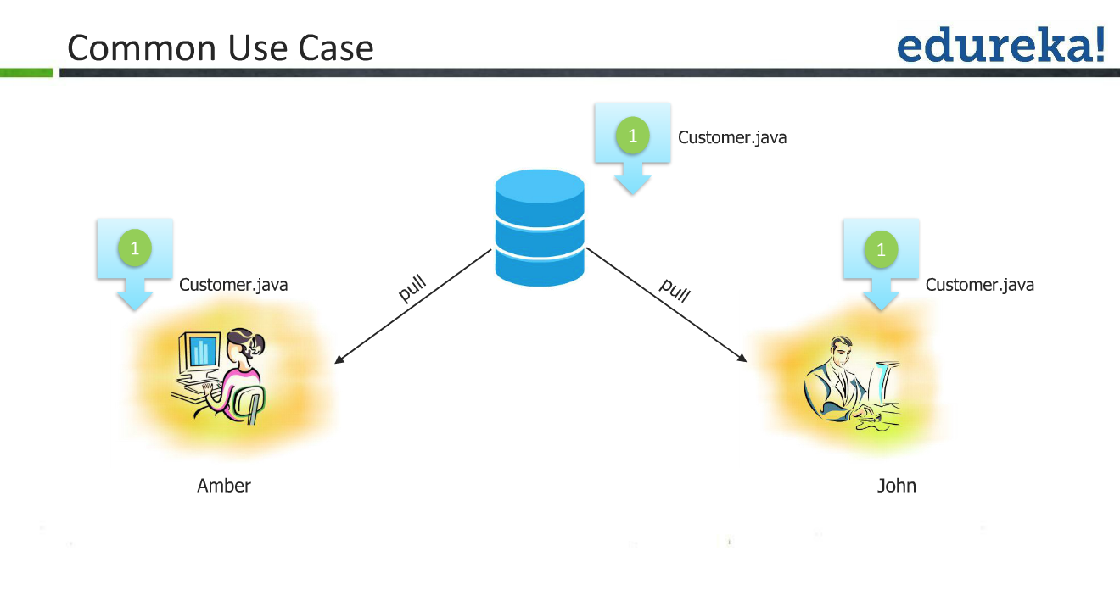

Slide 44
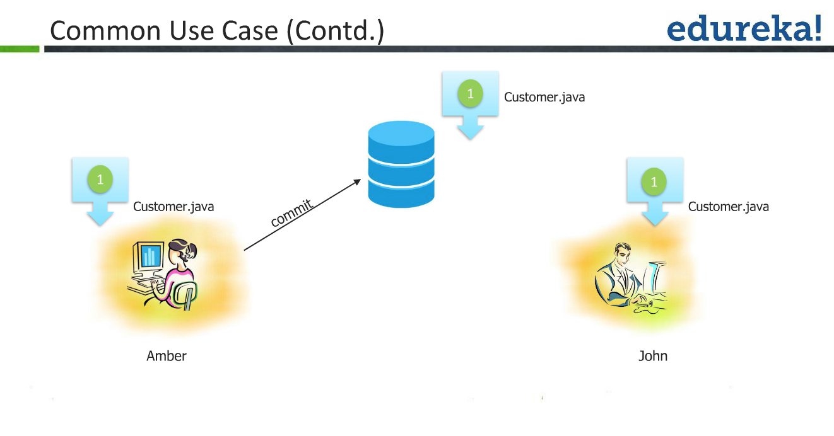

Slide 45
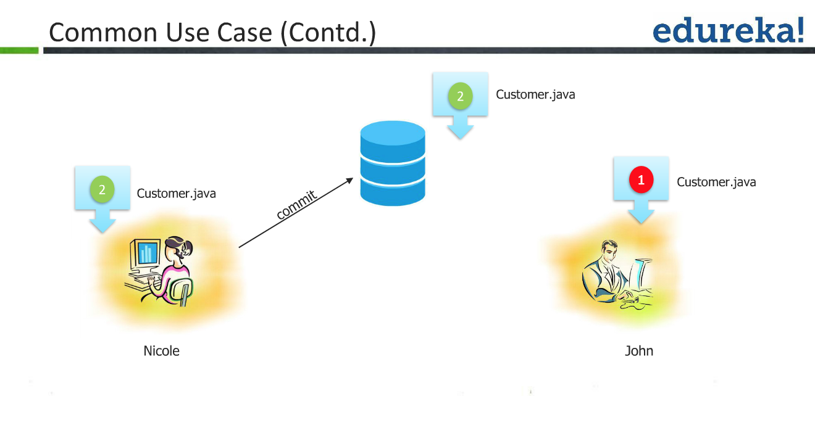

Slide 46
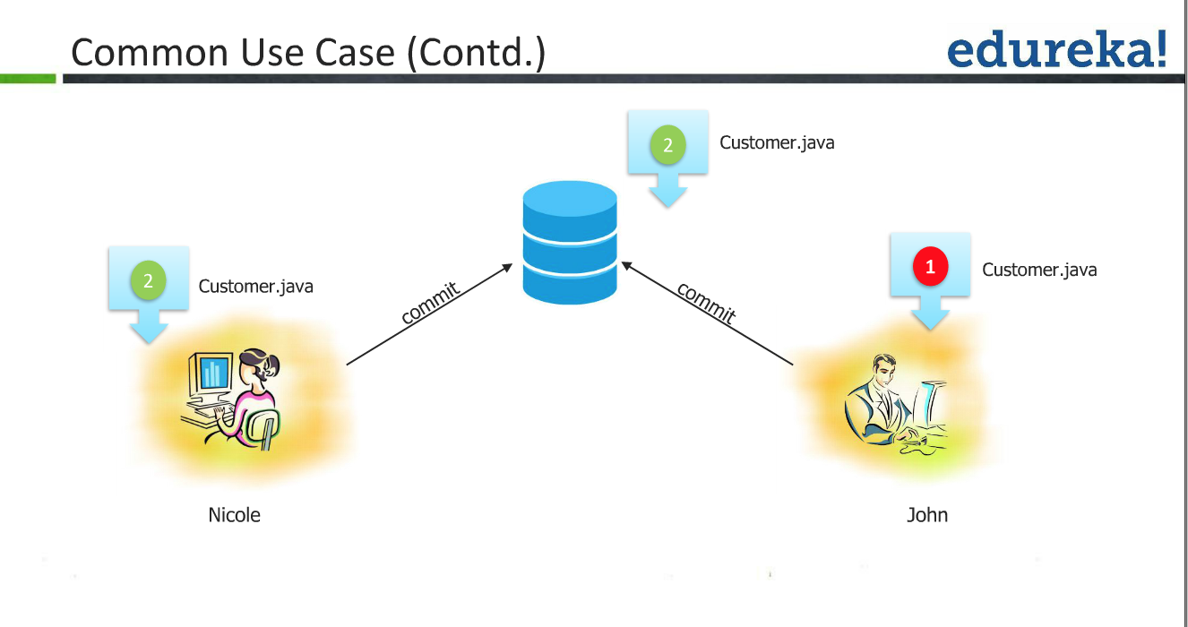

Slide 47
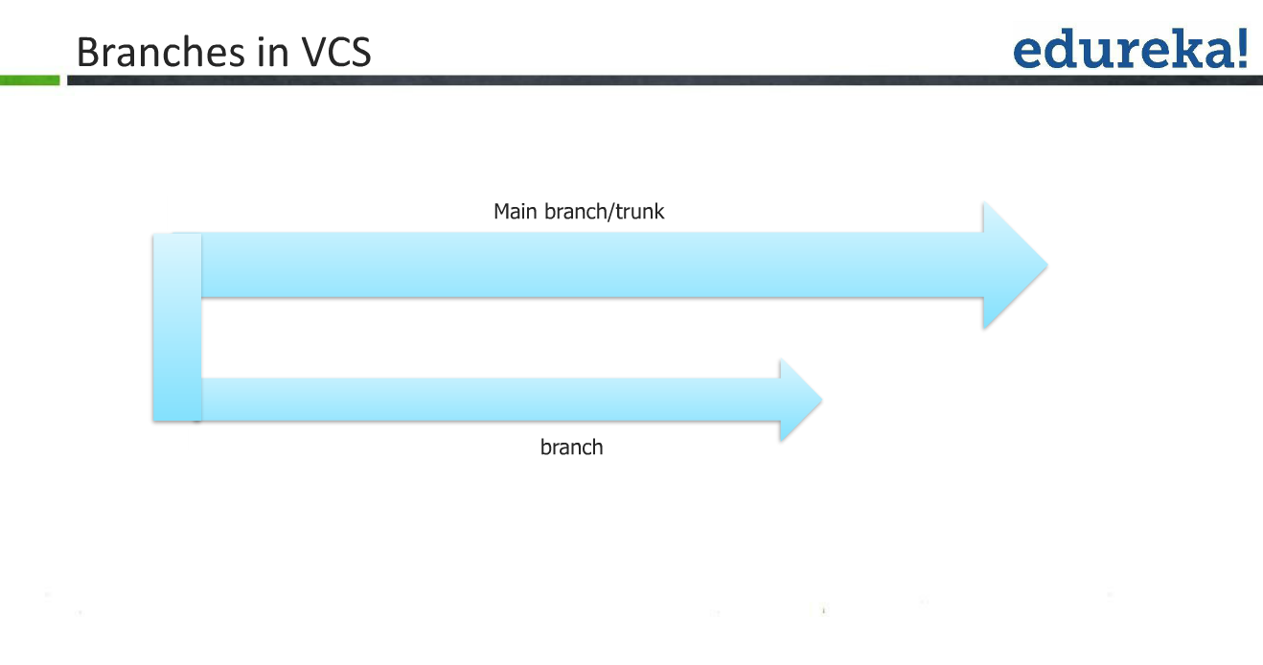

Slide 48
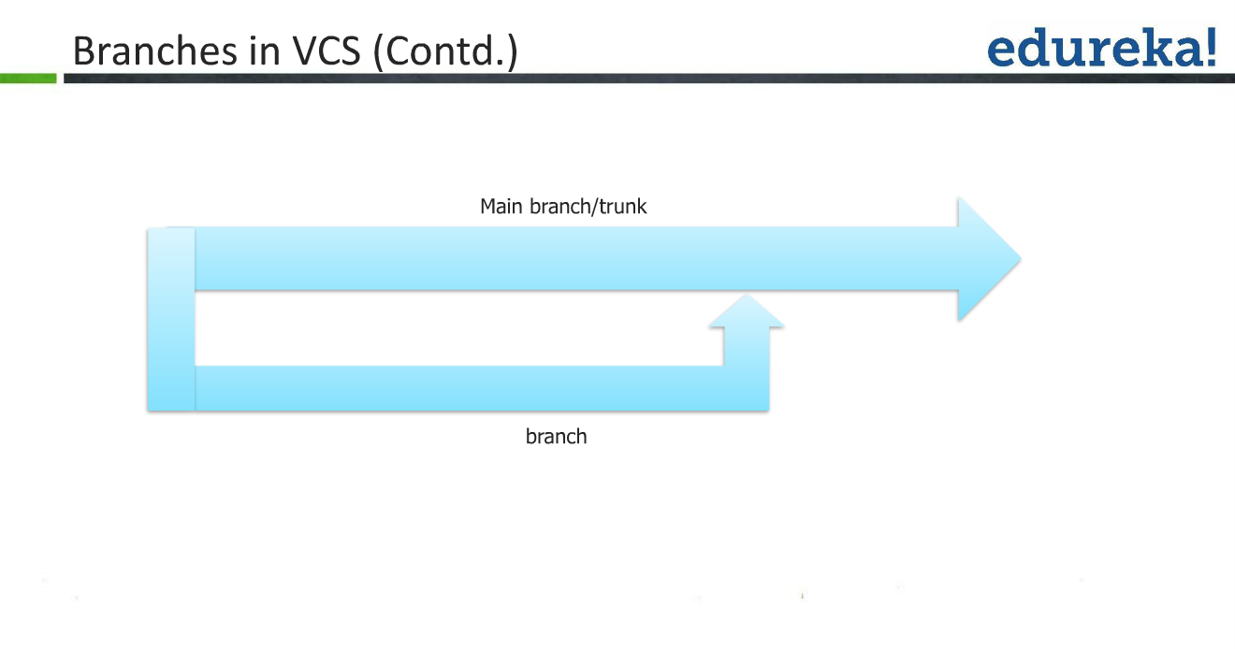

Slide 49
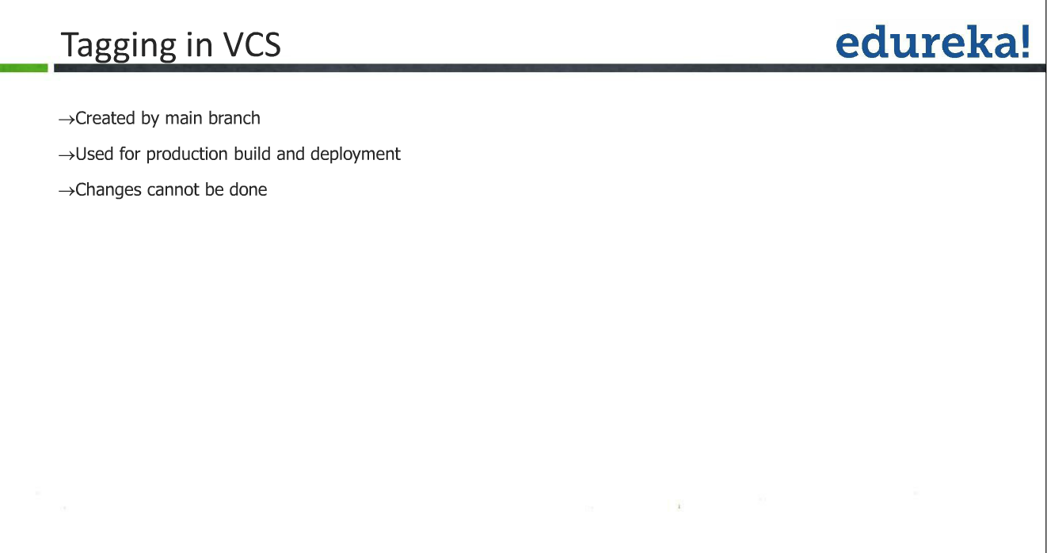

Slide 50
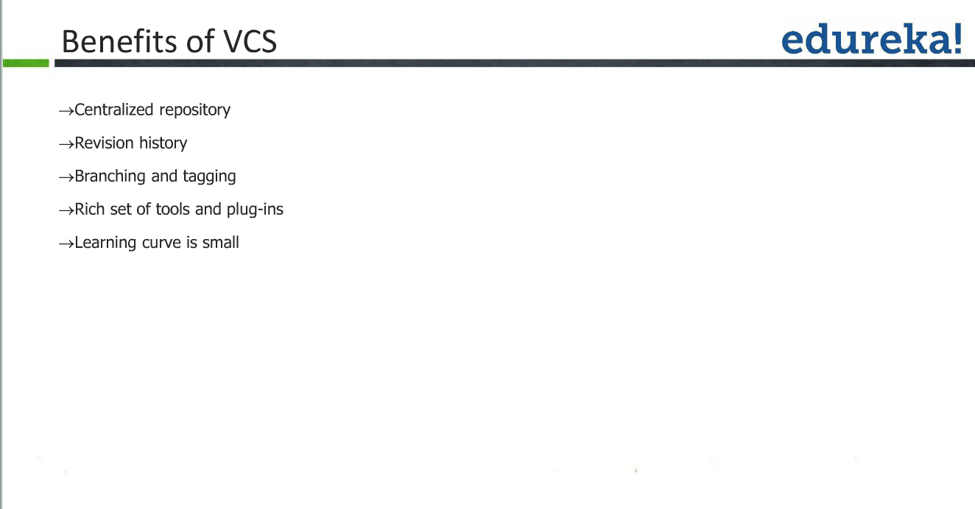

Slide 51
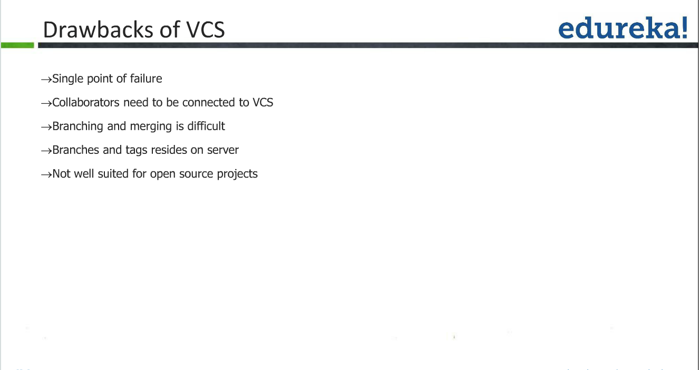

Slide 52
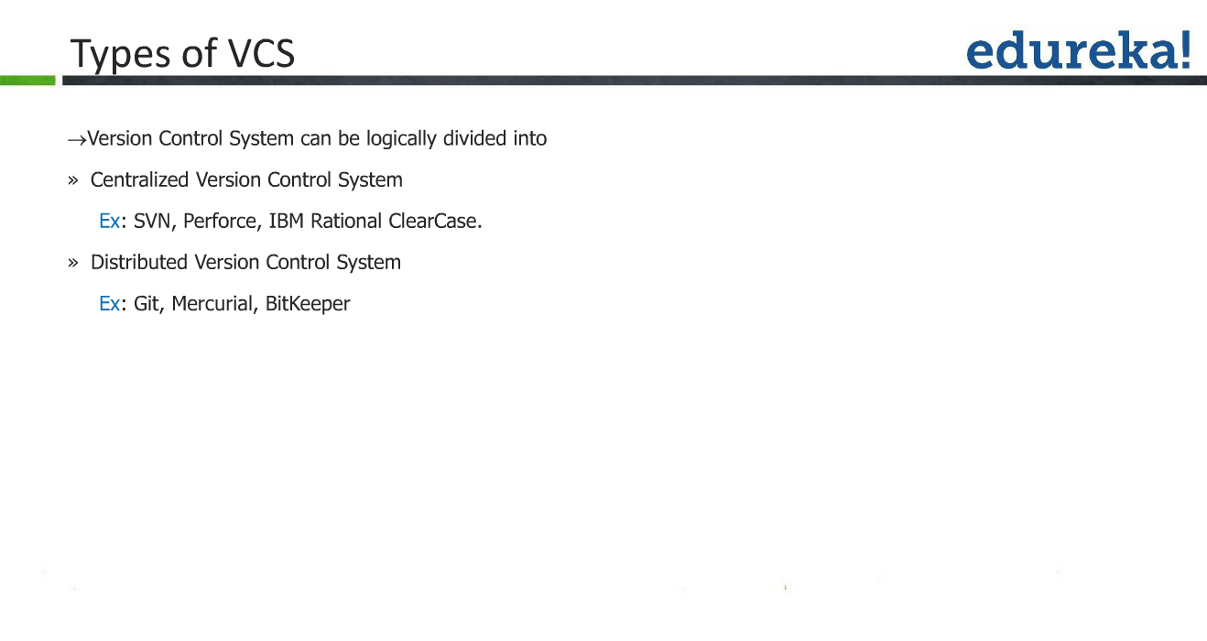

Slide 53
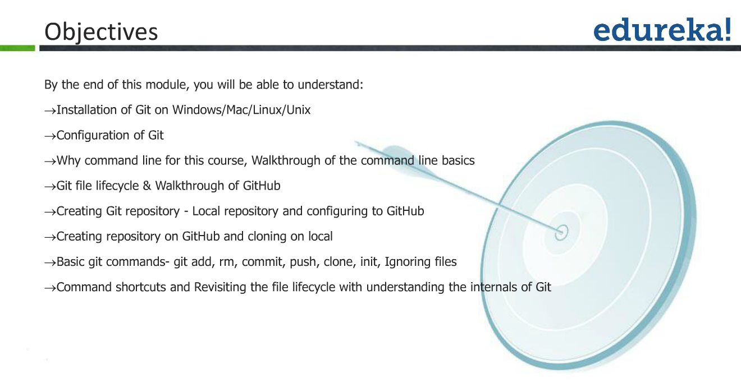

Slide 54
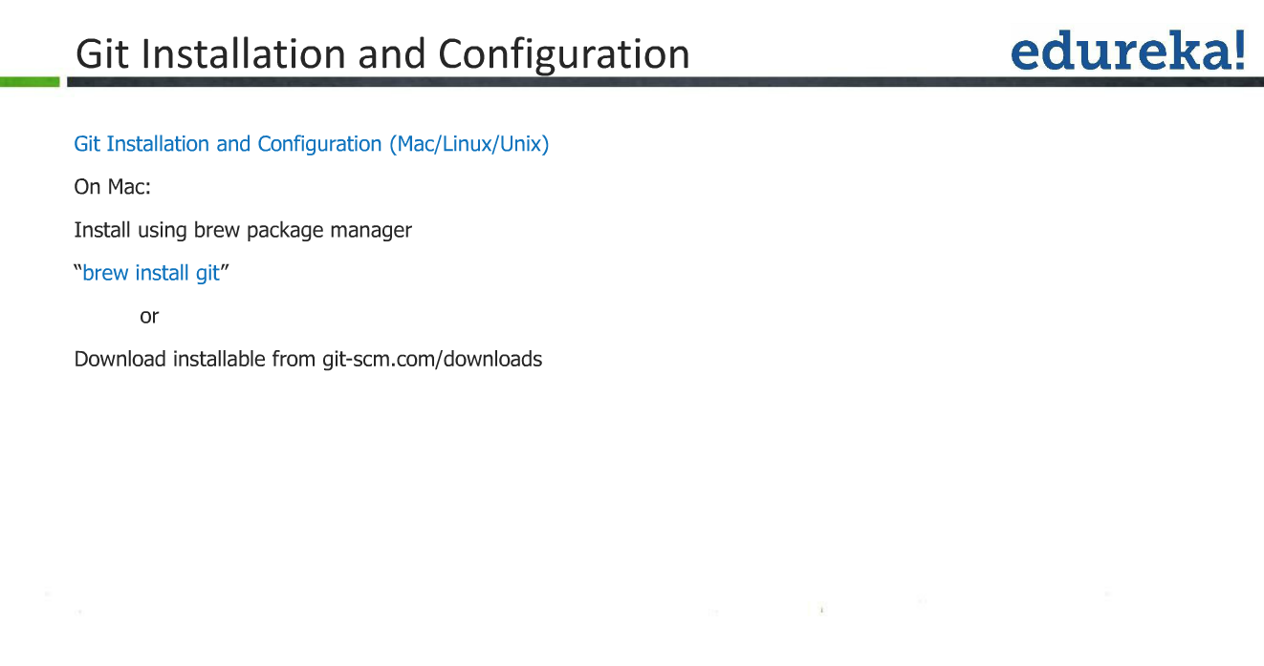
Use the Installation files in EMS Course Resources and Install GIT on your computer.
Git for Mac
Git for Windows
Installation will enable you to have unix command prompt in your Windows computer.
Install appropriate version applicable to your operating systems for Windows 32bit or 64bit Windows OS
windows
mac
https://www.udacity.com/wiki/ud775/install-git/install-git-mac
https://www.udacity.com/wiki/ud775/install-git/install-git-windows

Slide 55


Slide 56


Slide 57


Slide 58


Slide 59


Slide 60


Slide 61


Slide 62


Slide 63


Slide 64


Slide 65


Slide 66


Slide 67


Slide 68


Slide 69


Slide 70


Slide 71


